Slide 1
Working with jQuery Mobile

Slide 2
Objectives
In this session, you will learn to:
  Enhance a jQuery Mobile application

Slide 3
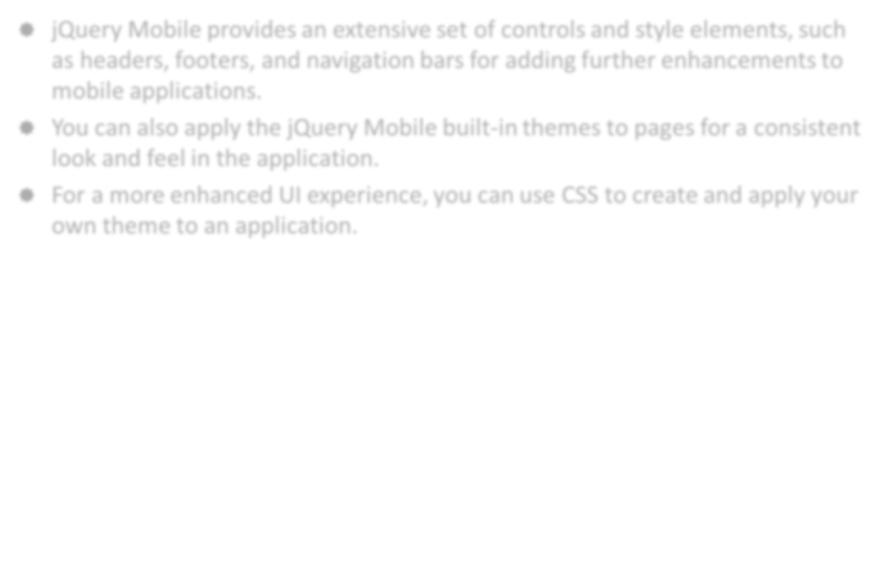
Enhancing a jQuery Mobile Application
jQuery Mobile provides an extensive set of controls and style elements, such as headers, footers, and navigation bars for adding further enhancements to mobile applications.
You can also apply the jQuery Mobile built-in themes to pages for a consistent look and feel in the application.
For a more enhanced UI experience, you can use CSS to create and apply your own theme to an application.

Slide 4
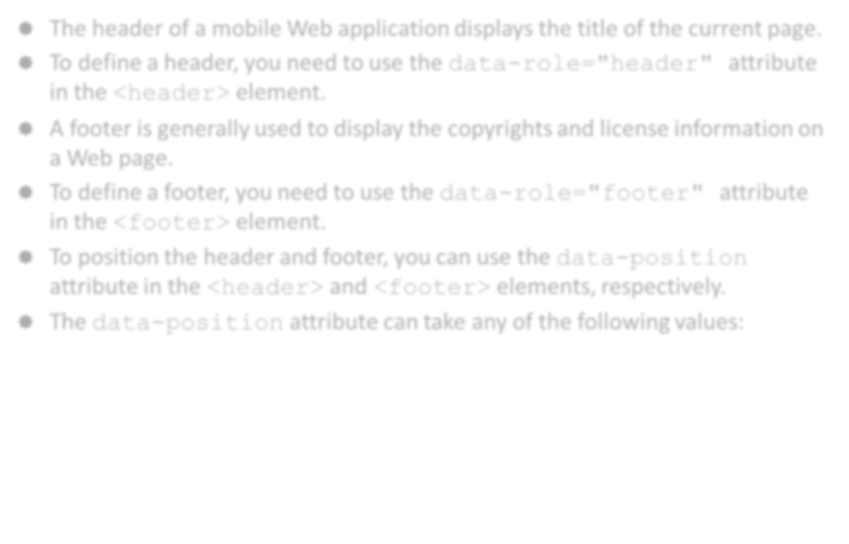
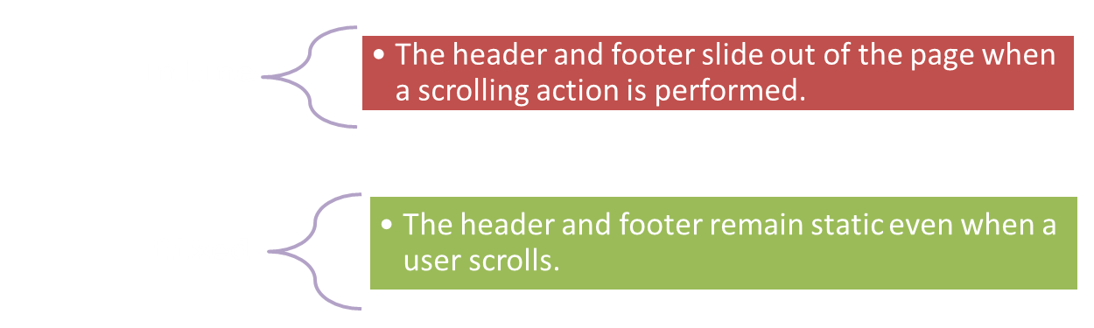
Working with Headers and Footers
The header of a mobile Web application displays the title of the current page.
To define a header, you need to use the data-role="header" attribute in the <header> element.
A footer is generally used to display the copyrights and license information on a Web page.
To define a footer, you need to use the data-role="footer" attribute in the <footer> element.
To position the header and footer, you can use the data-position attribute in the <header> and <footer> elements, respectively.
The data-position attribute can take any of the following values:

Slide 5
Working with Headers and Footers (Contd.)
The following code snippet shows how to add a fixed header and footer in a page:
<body>
<div id="page1" data-role="page" data-fullscreen="true">
<header data-role="header" data-position="fixed">
<h1> Header Content </h1></header>
<div data-role="main" class="ui-content">
<h3>This is the Content Area.</h3>
</div>
<footer data-role="footer" data-position="fixed">
<h3> Footer Content </h3></footer>
</div>
</body>

Slide 6
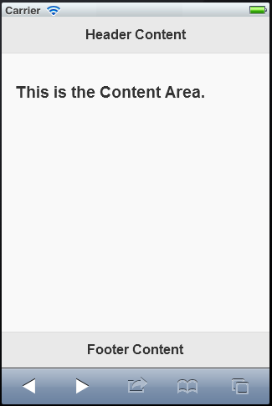
Working with Headers and Footers (Contd.)
The following figure shows the fixed header and footer in a page.

Slide 7
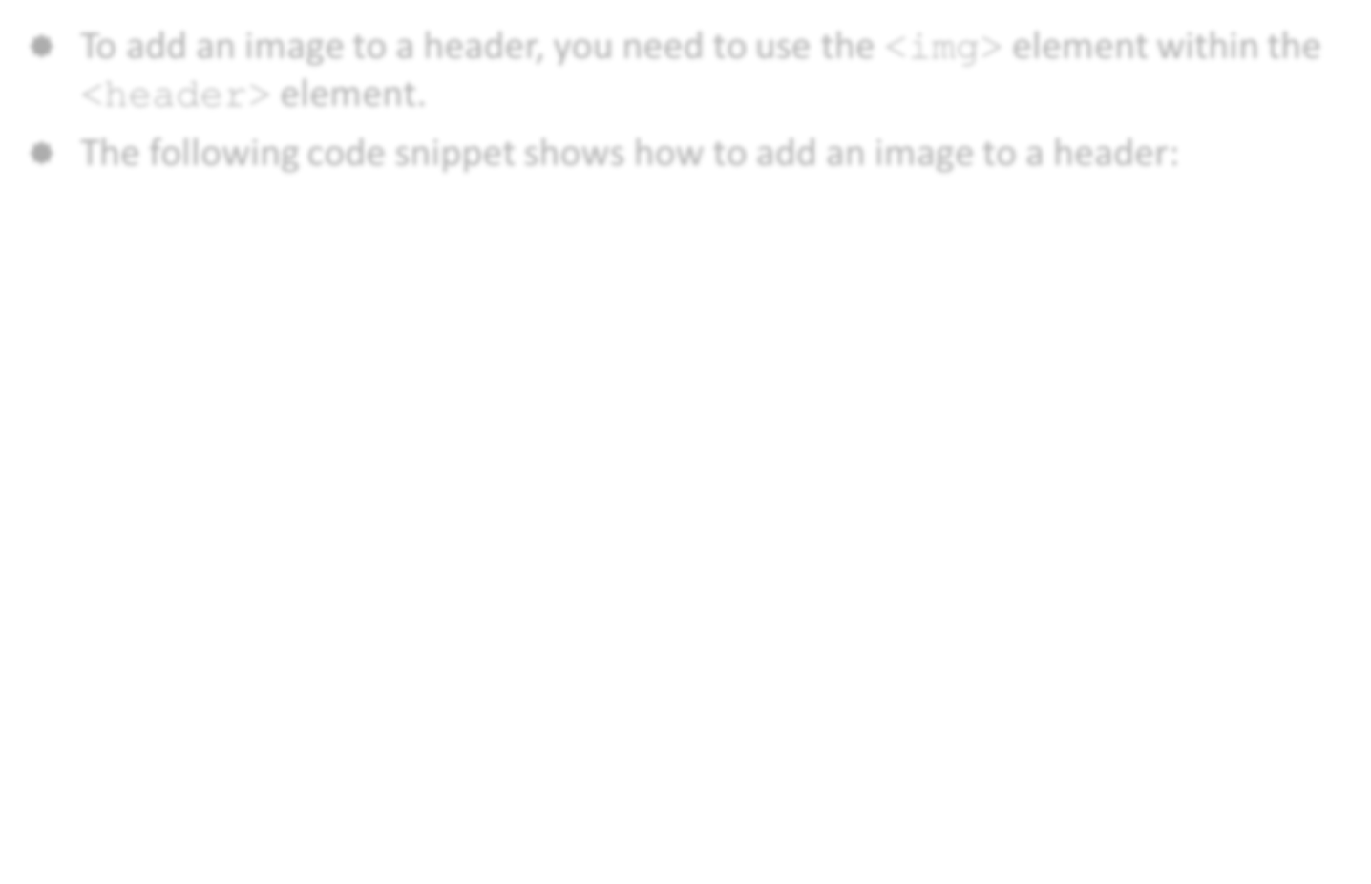
Working with Headers and Footers (Contd.)
To add an image to a header, you need to use the <img> element within the <header> element.
The following code snippet shows how to add an image to a header:
<header data-role="header" data-position="fixed">
<img src="AppImages/facebook_logo.png" alt="Facebook Logo" style="float:left;display:inline"/>
Header Content
</header>

Slide 8
Using Navigation Bars
A navigation bar is a full-screen-wide bar that you can use to place buttons and links that allow users to navigate between pages of an application.
To add a navigation bar in a page, you need to use the data-role="navbar" attribute inside the container element.
You can then add one or more link buttons using the <a> element with the data-role="button" attribute.
To highlight the first link button, labeled Home on the navigation bar of the home page, you need to use the class="ui-btn-active".

Slide 9
Using Navigation Bars (Contd.)
To fix the position of the navigation bar, you can add the
data-position="fixed" attribute to the <div> element containing the data-role="header" attribute that encloses the navigation bar, as shown in the following code snippet:
<div data-role="header" data-id="header1"
data-position="fixed" >
<h1>Products</h1>
<div data-role="navbar">
<a href="#home" data-role="button">Home</a>
<a href="#" data-role="button"
class="ui-btn-active ui-state-
persist">Products</a>
</div>

Slide 10
Using Buttons
Buttons are integral part of a mobile Web page.
Buttons can be used to navigate between pages, submit Web forms, or simply perform some dynamic interaction, such as to reset the field values of a form or to exit the application.
The following code snippet shows how to add submit button in a page:
<body>
<div id='mypage' data-role='page'>
<div data-role="main" class="ui-content">
<p>Submit Button Example</p>
<input type="submit"
value="Submit" data-inline="true">
</div>
</div>
</body>

Slide 11
Using Buttons (Contd.)
In addition to submit buttons, you can use the <button> element to render buttons that a user can click to interact with a Web page.
The following code snippet shows how to use a <button> element to display content on a Web page:
<script>
$(document).on("pageinit", function(event) {
$("#viewcontentbtn").bind("click", function(event, ui) { var str="Hello from jQuery Mobile";
$("#content").html(str); });
}); </script> </head>
<body>
<div id="main" data-role="page">
<div data-role="main" class="ui-content">
<button id="viewcontentbtn"> View Content </button> <br>
<div id="content"></div>
</div>
</div>
</div>
</body>

Slide 12
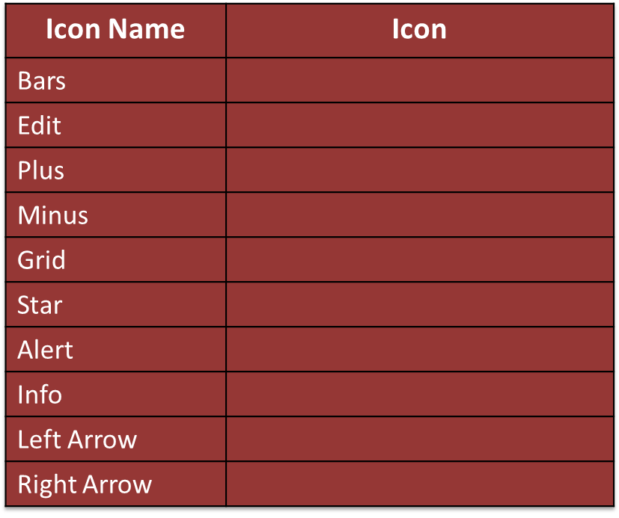
Using Buttons (Contd.)
To add an icon to a button, you need to use the data-icon attribute in the <a> element of a link button, <input> element of a submit button, or in the <button> element.
The following table lists some of the commonly used jQuery Mobile button icons.

Slide 13
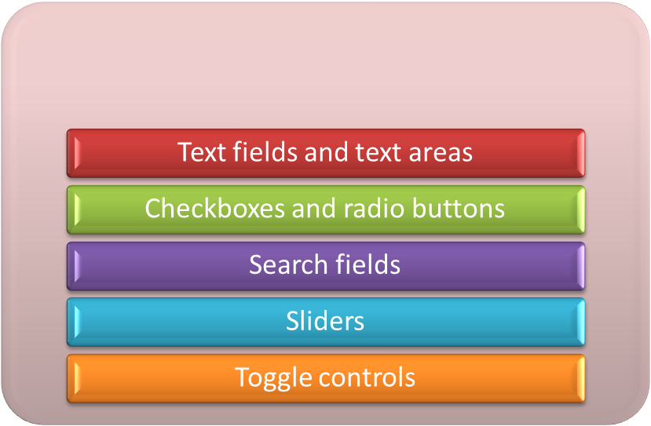
Using Form Input Controls
A jQuery Mobile form is similar to any other Web form, such as login and registration forms that you use to input and submit data.
A jQuery Mobile will automatically size and position the controls based on the device screen size.
The various types of input form controls supported by jQuery mobile are:

Slide 14
Using Form Input Controls (Contd.)
To add a text field, you need to use the <input> element with the type attribute set to text, as shown in the following code snippet:
To add a text area, you need to use the <textarea> element, as shown in the following code snippet:
<input type="text" name="textfield1" id= "text " placeholder="This is a text field."/>
<textarea cols="5" rows="80" name="textarea1" id="textarea"
placeholder=" This is a text area."></textarea>

Slide 15
Using Form Input Controls (Contd.)
To use checkboxes and radio buttons on a page, you need to group the checkboxes and radio buttons.
You can group checkboxes and radio buttons on a page by using the controlgroup value of the data-role attribute in the <fieldset> element.
The following code snippet shows how to add groups of checkboxes:
<fieldset data-role="controlgroup">
<p>Select a Book Genre:</p>
<label for="fiction">Fiction</label>
<input type="checkbox" name="fiction" id="fiction">
<label for="biography">Biography</label>
<input type="checkbox" name="biography" id="biography">
<label for="novel">Novel</label>
<input type="checkbox" name="novel" id="novel">
</fieldset>

Slide 16
Using Form Input Controls (Contd.)
A search field refers to a text field that allows users to specify text to search specific content in a page.
A search field displays a magnifying glass icon on the top left side of the page.
To add a search field in a page, you need to set the value of the type attribute as search in the <input> element, as shown in the following code snippet:
<body>
<div id='main' data-role='page'>
<div data-role="main" class="ui-content">
<label for="searchfield">Search:</label>
<input type="search" name="search" id="searchfield" value="Enter Search
Text"/>
</div>
</div>
</body>

Slide 17
Using Form Input Controls (Contd.)
You can use sliders when you want to allow a user to select a value from a range of values by sliding back and forth.
To create a slider, you need to specify the value of the type attribute of the <input> element as range.
To specify a range for the slider, you need to use the min and max attributes that specify the minimum and maximum values of the range that the slider will display, as shown in the following code snippet:
<body>
<div id="main" data-role="page">
<div data-role="main" class="ui-content">
<label for="slider-1">Input slider:</label>
<input type="range" name="slider-1" id="slider-1" value="40" min="0" max="100" />
</div>
</div>
</body>

Slide 18
Using Form Input Controls (Contd.)
A toggle control allows a user to toggle between two options.
To add a toggle control in a jQuery Mobile page, you need to set the value of the data-role attribute as slider in the <select> element.
To specify options using which users can toggle back and forth, you can use the <option> elements within the <select> element, as shown in the following code snippet:
<div data-role="main" class="ui-content">
<label for="slider-voice-recording">Voice Recording</label>
<select name="slider-voice-recording" id="slider-voice-recording" data-role="slider">
<option value="on">On</option>
<option value="off">Off</option>
</select>
</div>

Slide 19
Positioning Form Input Controls
You can use a layout grid in a jQuery Mobile page to place and position controls in columns next to each other.
A layout grid does not contain any borders or margins.
Before creating a layout grid, you need to understand about:
  Grid container: Is a container of form elements that allows positioning the elements in columns. It allows specifying the number of columns in a grid. For example, to create a two-column grid, you need to set the ui-grid-a attribute inside a container element, such as <div>.
  Block: Is part of a grid container that enables specifying the column position where form elements will be positioned. For example, when you use a two-column grid, the first block should be specified with the ui-block-a attribute and the second block should be specified with the ui-block-b attribute.

Slide 20
Positioning Form Input Controls (Contd.)
The following code snippet shows how to add multiple controls in a page using layout grid and position them in a jQuery page.
<body>
<div id="main" data-role="page">
<div data-role="main" class="ui-content">
<div class="ui-grid-b">
<div class="ui-block-a">Block A <p> Block A Content</p></div>
<div class="ui-block-b">Block B <p> Block B Content</p></div>
<div class="ui-block-c">Block C <p> Block C Content</p></div>
</div>
</div>
</div>
</body>

Slide 21
Applying Themes and Swatches
A theme is a visual concept that you can use to design UIs of a mobile Web application with consistent color and texture without affecting the page design.
You can apply a theme in a jQuery Mobile page by using swatches.
A swatch defines colors of a page and its controls.
The following code snippet shows how to use themes in a jQuery Mobile page:
<div id="mainpage" data-role="page">
<header data-role="header" data-theme="a">
<h1> Header Content </h1>
</header>
<div data-role="content" class="ui-content" data-theme="b">
<h3>This is the Content Area.</h3>
</div>
<footer data-role="footer" data-theme="a">
<h3> Footer Content</h3>
</footer>
</div>

Slide 22
Customizing Page Backgrounds and Font Styles
jQuery Mobile enables you to customize background colors of Web pages and font styles.
By default, jQuery mobile uses the white background color and font styles with Helvetica, Arial, and Sans-Serif font family.
To create a custom page background, you need to define the background CSS property and refer it in the page container using the class attribute.
To use different types of fonts, you need to use CSS properties, such as
font-family, color, and text-align, and refer them from the controls where you need to use them.

Slide 23
Just a Minute
By default, the jQuery Mobile Framework provides _____ font styles.
  three
  two
  five

Slide 24
Just a Minute (Contd.)
Answer
  three

Slide 25
Activity: Using Forms in a jQuery Mobile Application
You have created the initial structure of the PizzaBud application. Now, you need to enhance the application. Based on the requirements given by the management of PizzaBud, you need to add and position a header and footer to the existing pages of the application. To address the branding requirements of the application, you need to add the PizzaBud logo in the header. You also need to create a navigation bar with buttons to allow users to navigate between the existing pages instead of clicking on the existing links.
Also, as a part of the next development phase of the PizzaBud application, you need to add a registration page in the application. Users can register with the application by providing their details in the registration page to avail special discounts and promotional notifications. In the registration page, you need to use the grid layout to position those elements that are not optimally displayed in a device screen.
Prerequisite: To perform this activity, you need the PizzaBud.zip file.

Slide 26
Activity: Applying Themes in a jQuery Mobile Application
You have enhanced the PizzaBud application and have also added a registration form. You have submitted the application for review to Patrick, your Project Head. Patrick, based on the PizzaBud management feedback, has appreciated your effort. However, Patrick informs you that the client has suggested the need to brand the visual look and feel of the application. Now, you need to update the PizzaBud application based on the branding requirements of the client.
You need to ensure that:
  All the headers and footers of the application pages use the swatch b theme for a darker look.
  All the pages of the application should have a yellow background color.
  All the fonts used in the content area of the application pages should be Verdana.
Prerequisite: To perform this activity, you need the PizzaBud.zip file.

Slide 27
Summary
In this session, you learned that:
  To define a header, you need to use the data-role="header" attribute in the <header> element.
  To define a footer, you need to use the data-role="footer" attribute in the <footer> element.
  To add a navigation bar in a page, you need to use the data-role="navbar" attribute inside the container element.
  Some of the key input form controls that you can use in a jQuery Mobile form are:
    Text fields and text areas
    Checkboxes and radio buttons
    Search fields
    Sliders
    Toggle controls
  To use a theme in a mobile Web page, you need to use the data-theme attribute in a page container, such as page, header, content, and footer.
  To create a custom page background, you need to define the background CSS property and refer it in the page container using the class attribute.

Slide 28
What’s Next?
After this session, you need to do the following tasks:
  Go through the recorded lecture on the following topic through Cloudscape:
    Working with jQuery Mobile
  Perform the following exercises of Chapter 9:
    Exercise 2
    Exercise 3
  Attend Cycle Test 7

